Slide 1
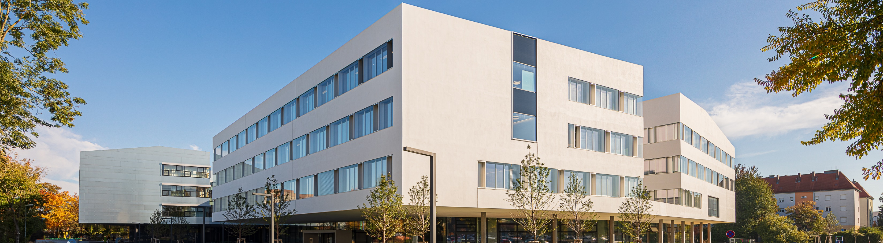
Final presentation
© Peter Rauchecker
Andone Alexandru (is220021)
Flita-Vasile Adrian (cr221504)
German Maria-Alexia (is230002)
Grigoras Ana-Maria (is220013)
Nema Alexandru David (is220017)
Zota Ana-Maria (is220020)
Lecturer: Jakub Pasikowski

Slide 2
Introduction
We will submit our audit report, which includes our conclusions and suggestions, during this presentation. Any areas where we found possible hazards or flaws in your systems and procedures will be highlighted in our report. We will also go through any encouraging results and strong points we found during our audit.
Applied controls:
ISO/IEC 27001:2013 Riskmanagement
ISO/IEC 27002:2022 8.23—8.34
CSC Top 18 Topic 3,1

Slide 3
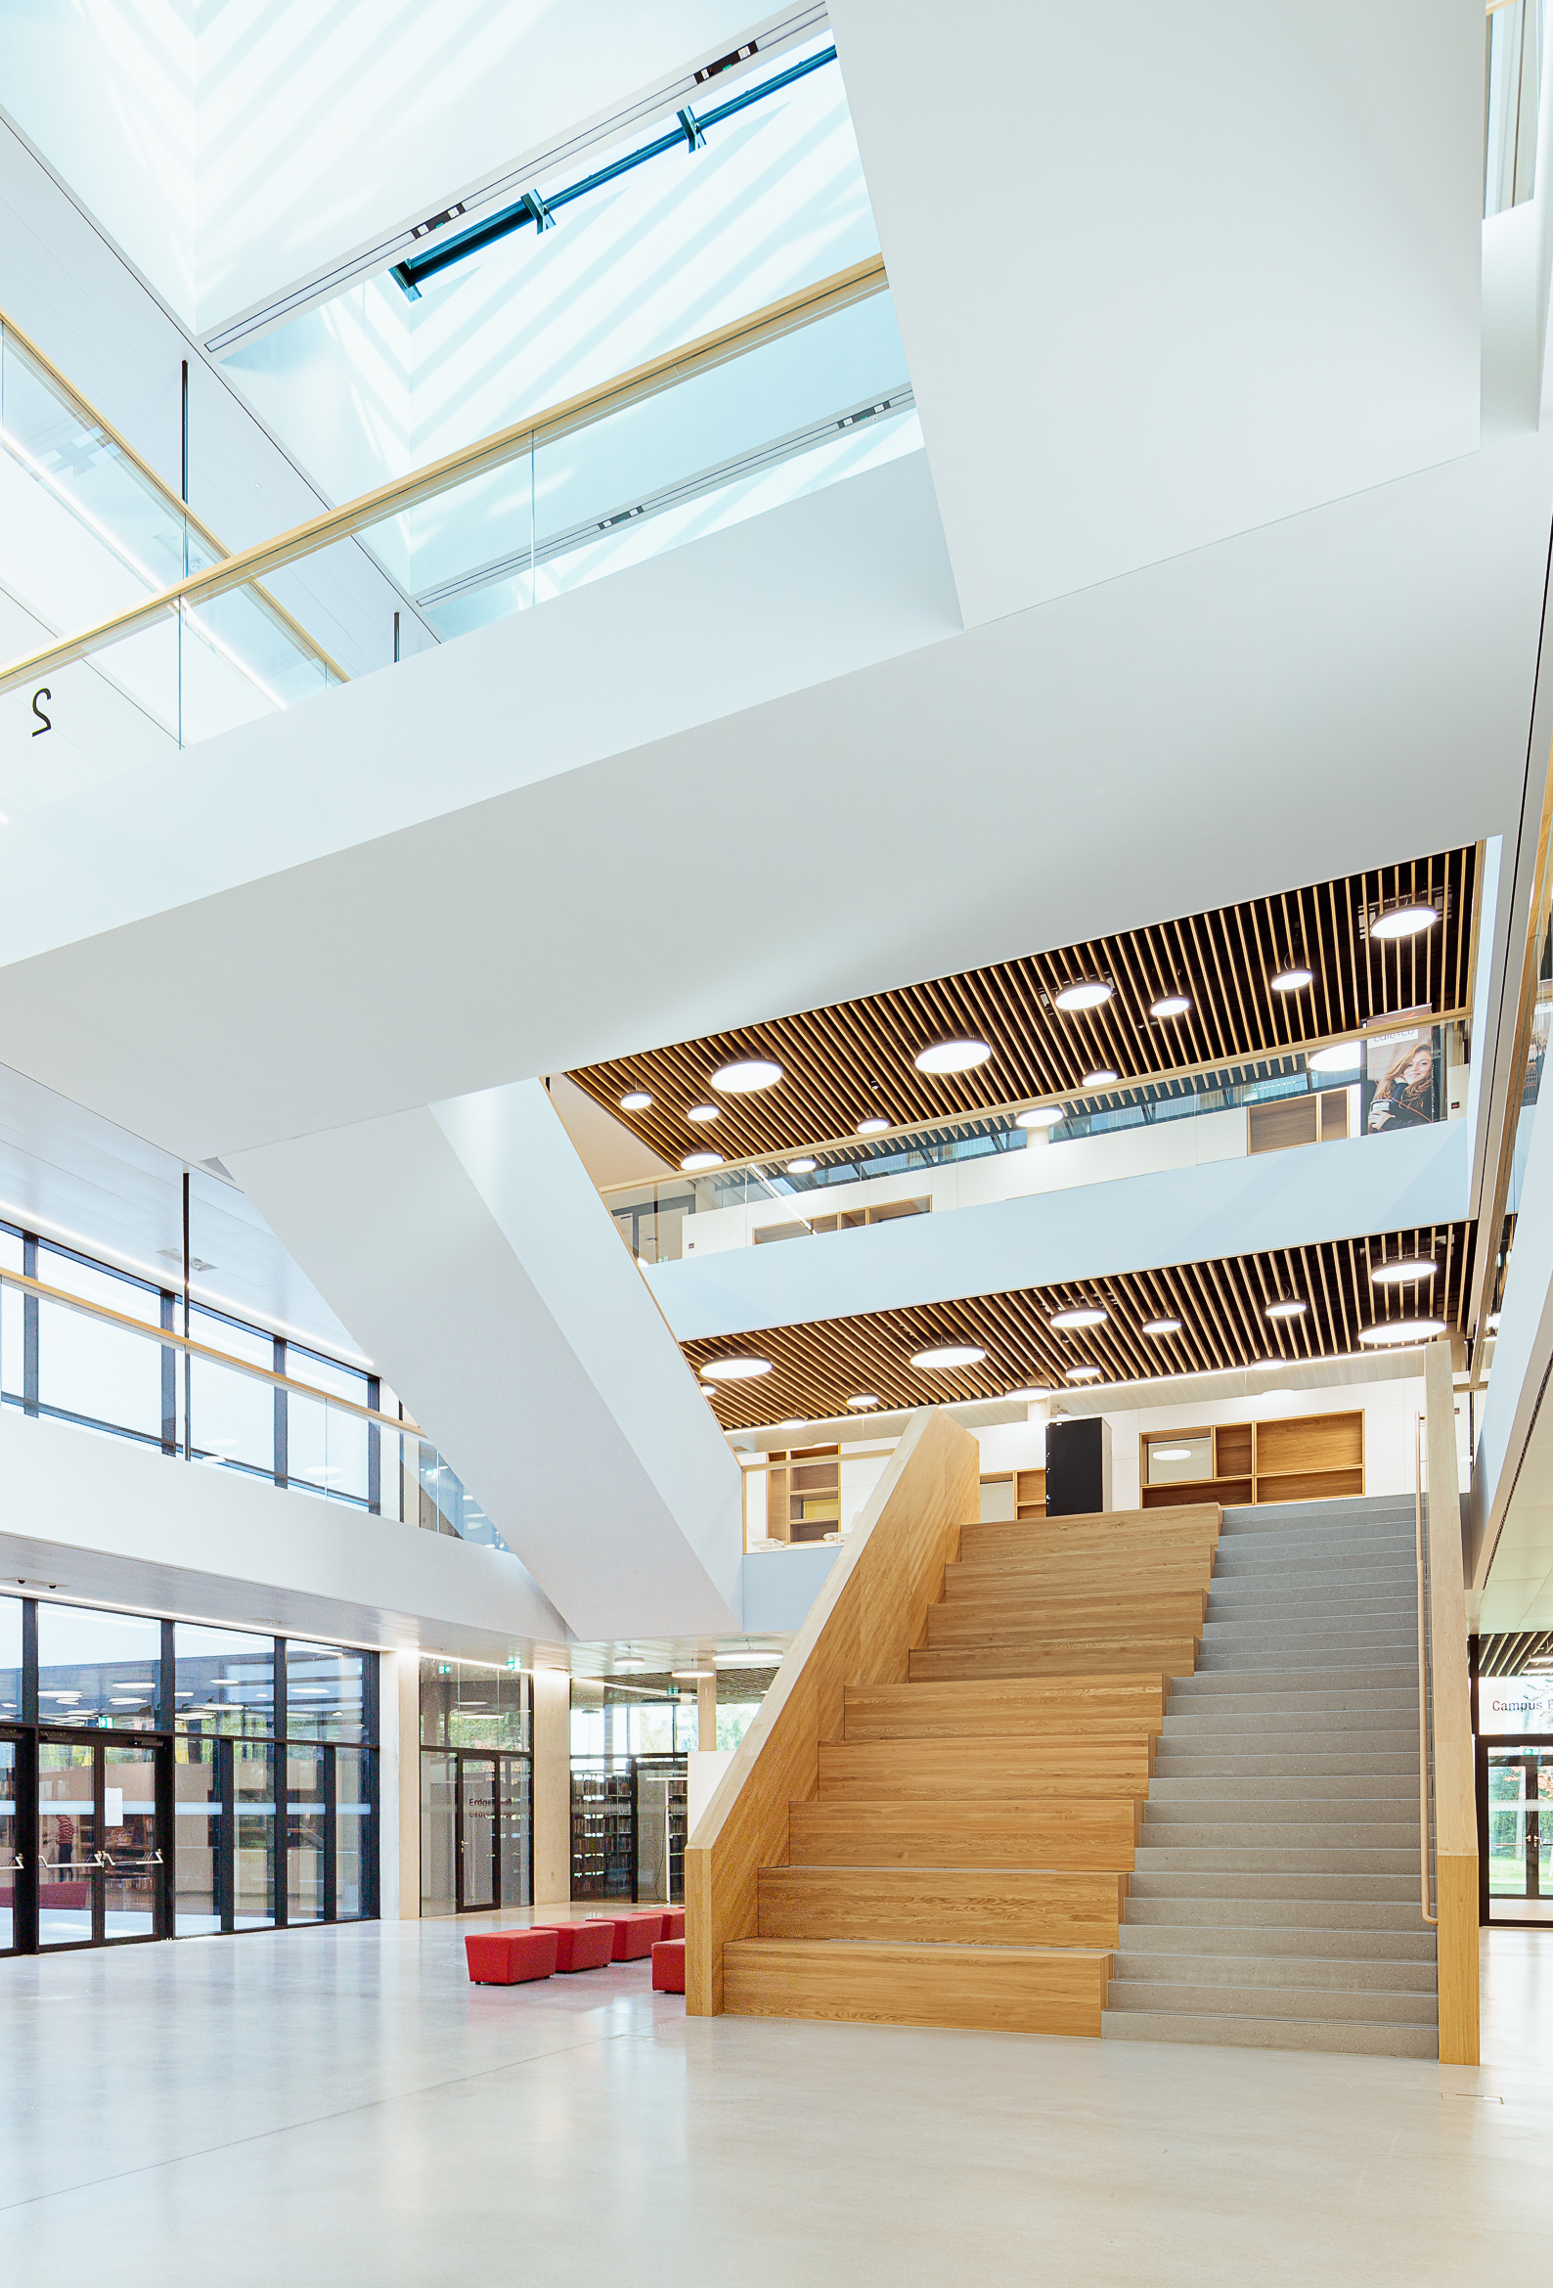
Strong Points
We are happy to inform you that we found a number of your systems and procedures to be strong. We want to take this time to recognize and praise your personnel for their commitment and hard work, which is reflected in these strong points.
Using SAP for inventory management.
Safe storing of risks and vulnerabilities in an organized manner.
Having escrow software agreement.
Always updating the policies
Risk assessment is done once a year following the rule of thumb.
© Peter Rauchecker

Slide 4
Risks Report
Throughout the audit, we found a number of potential risks that might affect the precision and thoroughness of our reporting. These risks highlight places where vulnerabilities may be more likely to occur, so it is crucial that we address them quickly and effectively.
Type of measurement scale:
Low risk
Medium risk
High risk

Slide 5
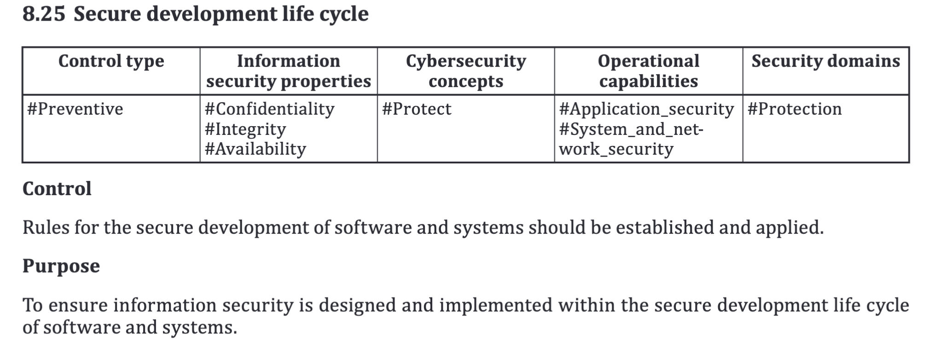
High risk
Recommendation:
A rule about code scans must be implemented.
Time of remediation :
Within 1 week

Slide 6
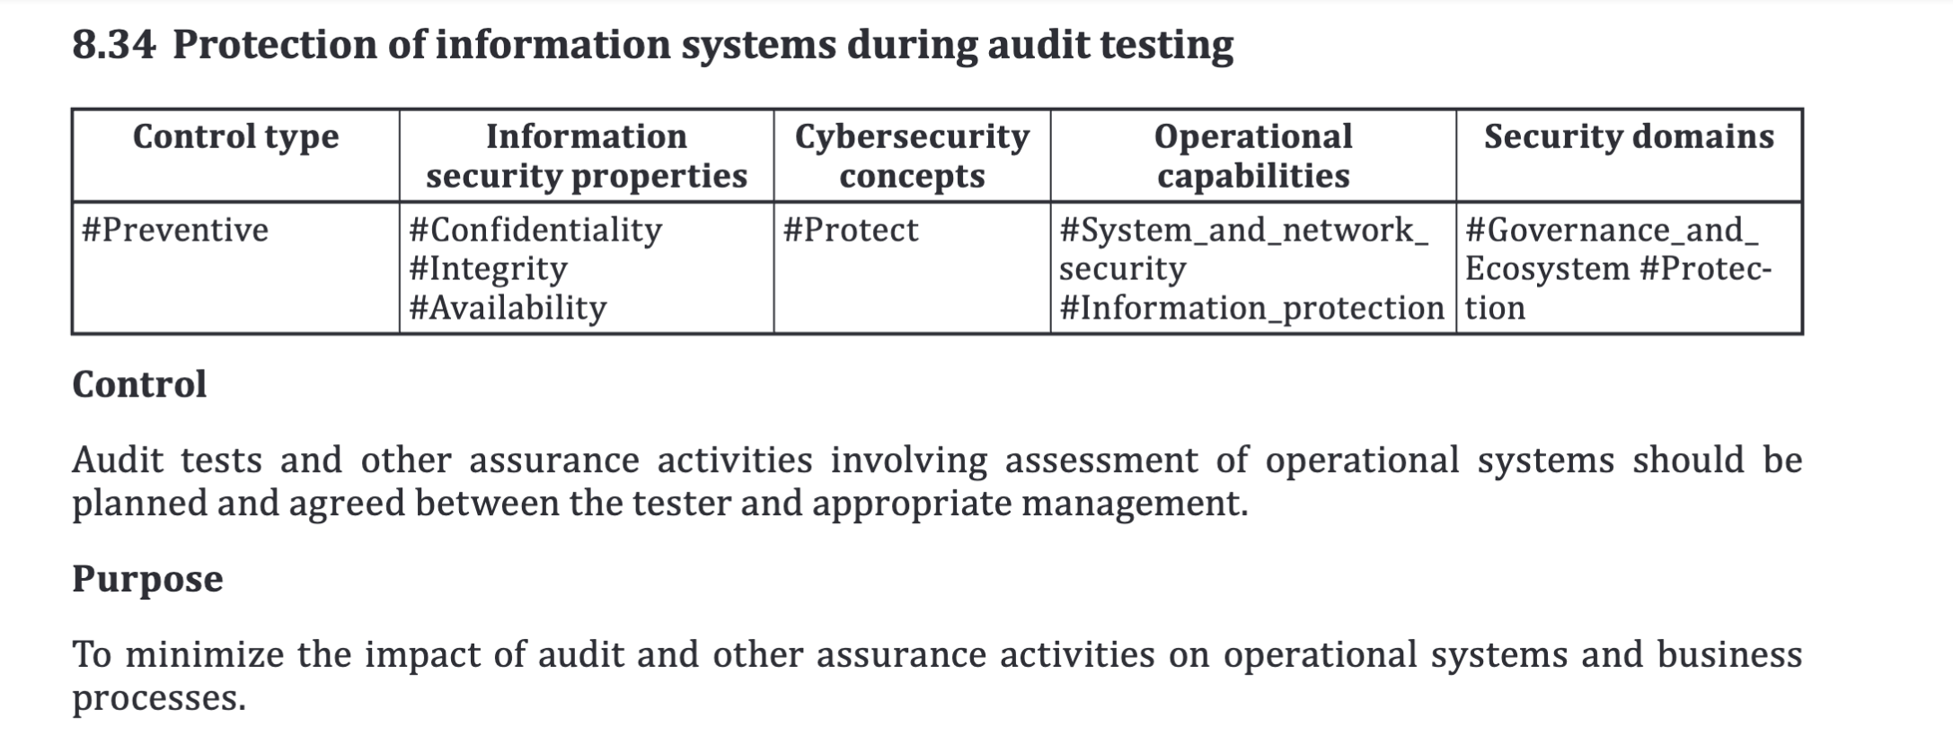
High risk
Recommendation:
Implement a system to enable verification of the security settings on employees' personal devices.
Time of remediation :
Within 1 week

Slide 7
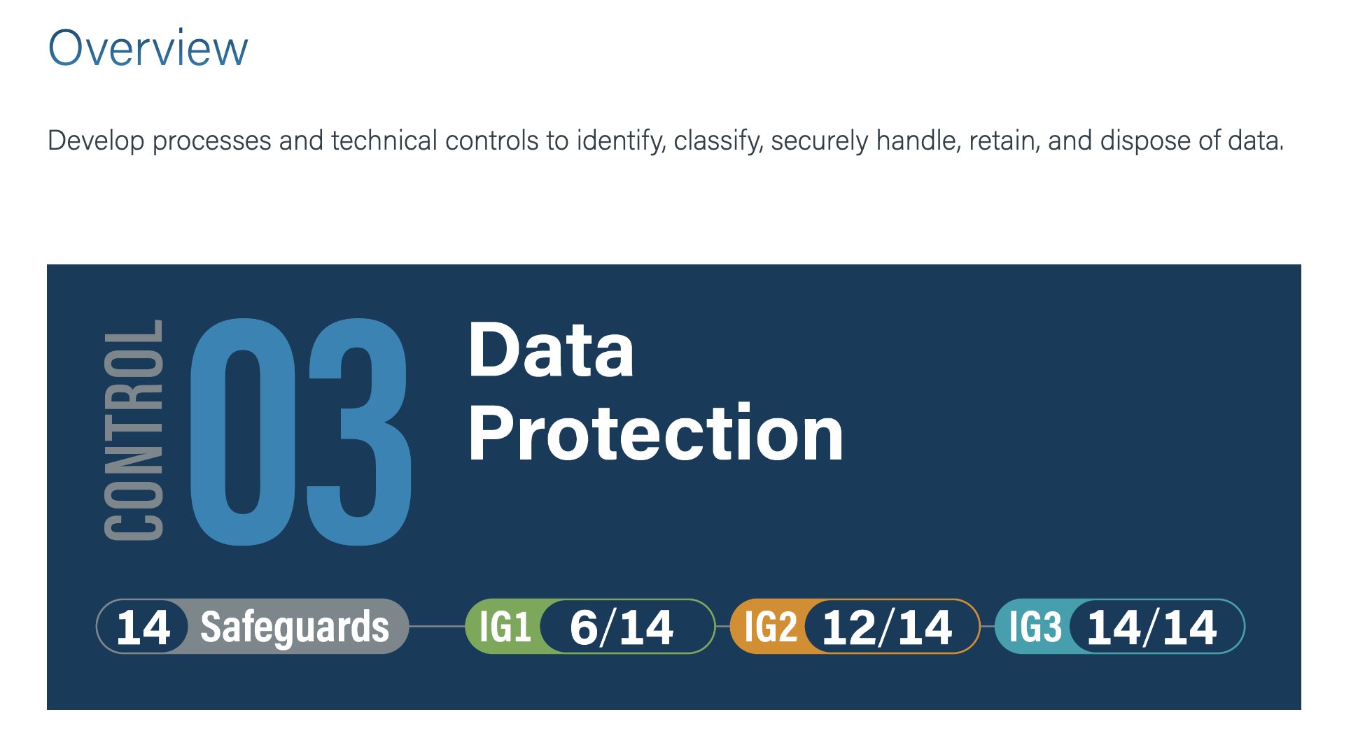
High risk
Recommendation:
If the device is not encrypted with bitlocker find a solution in order to wipe the data not only if the device receives an internet connection.
Time of remediation :
Within 1 week

Slide 8
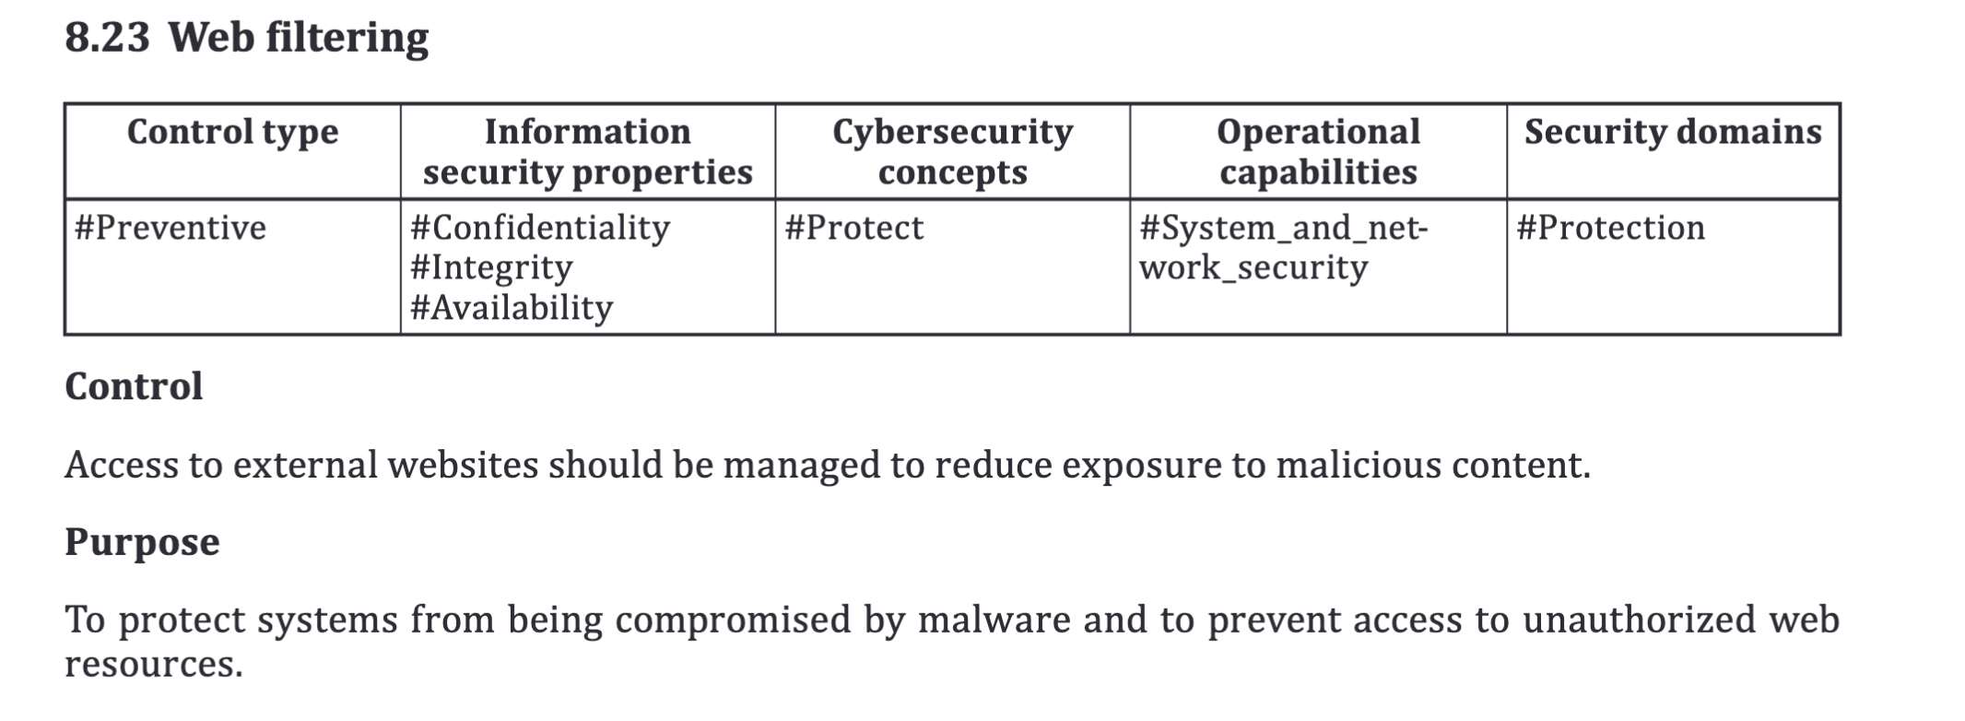
Medium risk
Recommendation:
Implement web filtering while working remotely.
Time of remediation :
Within 1 month

Slide 9
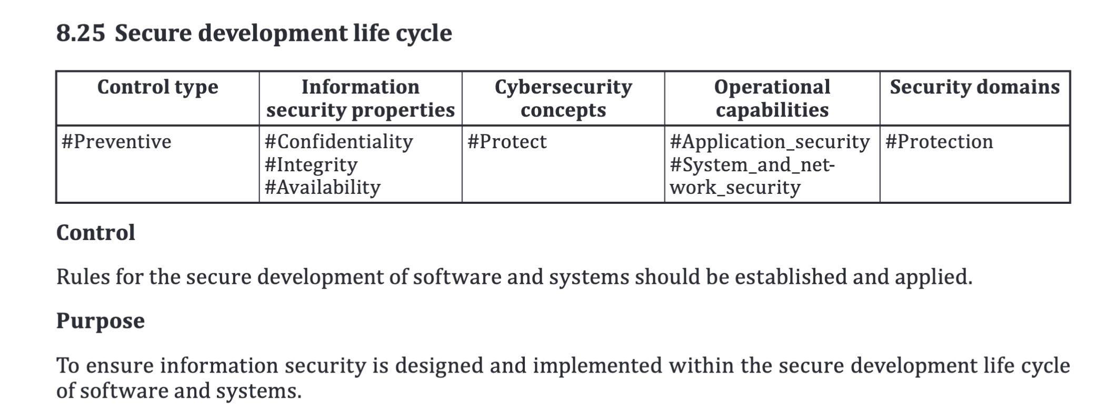
Medium risk
Recommendation:
Train developers to code securely.
Time of remediation :
Within 1 month

Slide 10
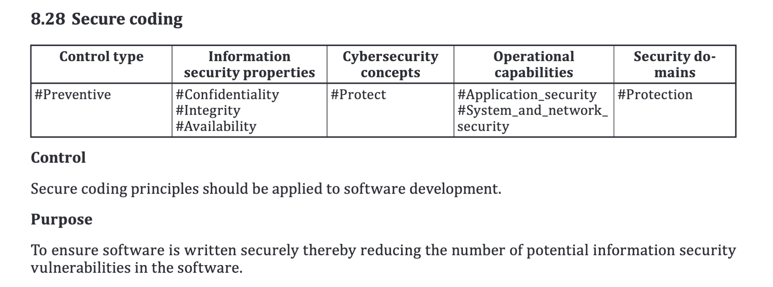
Medium risk
Recommendation:
Use licenses for external libraries.
Time of remediation :
Within 1 month

Slide 11
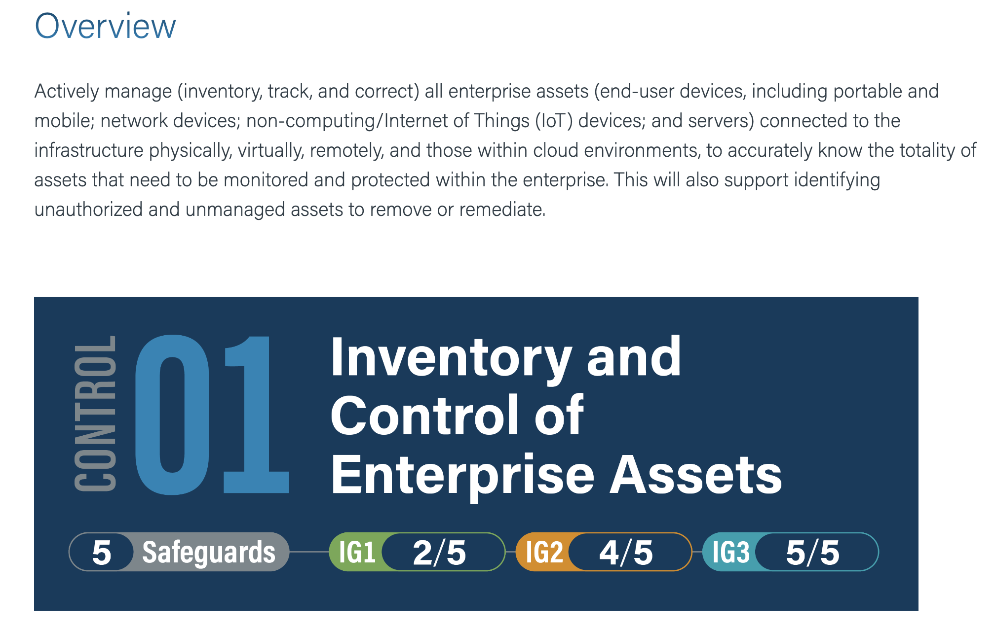
Low risk
Recommendation:
Establish a procedure in case of a piece of equipment is out of date or sold.
Time of remediation :
Within 3 months

Slide 12
Low risk
Recommendation:
Make the awareness training mandatory.
Time of remediation :
Within 3 months

Slide 13
Conclusion
I'd want to conclude by expressing my gratitude to everyone who attended this last audit meeting. Your organization's internal controls and processes have been thoroughly examined by our audit team, and we have delivered our findings and suggestions to you.
Thank you for your attention!

